Slide 1
Lecture 4 - Organisation Structure and Concepts
Managing Business

Slide 2
Learning Outcomes
At the end of the lecture, you should be able to:
  Describe each of the five forms of departmentalisation.
  Explain some alternative approaches to job design.
  Discuss how jobs can be enriched.

Slide 3
Defining Organisational Structure
Organisational Structure
  The formal arrangement of jobs within an organisation.
Organisational Design
  Developing or changing an organisation’s structure

Slide 4
Purposes of Organising
Divides work to be done into specific jobs and departments.
Assigns tasks and responsibilities associated with individual jobs.
Coordinates diverse organisational tasks.
Clusters jobs into units.
Establishes relationships among individuals, groups, and departments.
Establishes formal lines of authority.
Allocates and deploys organisational resources.

Slide 5

Organisational Structure
Work Specialisation
  The degree to which tasks in the organisation are divided into separate jobs with each step completed by a different person.
  Overspecialisation can result in human diseconomies from boredom, fatigue, stress, poor quality, increased absenteeism, and higher turnover.

Slide 6
Departmentalisation by Type
Functional
  Grouping jobs by functions performed
Product
  Grouping jobs by product line
Geographical
  Grouping jobs on the basis of territory or geography
Process
  Grouping jobs on the basis of product or customer flow
Customer
  Grouping jobs by type of customer and needs

Slide 7
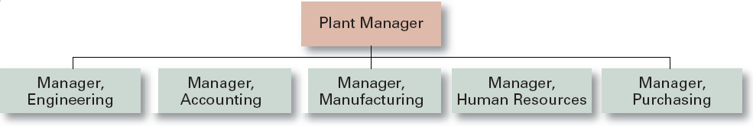
Functional Departmentalisation
Advantages
  Efficiencies from putting together similar specialties and people with common skills, knowledge, and orientations
  Coordination within functional area
  In-depth specialisation
Disadvantages
  Poor communication across functional areas (may not able to understand other division requirement)
  Limited view of organisational goals

Slide 8
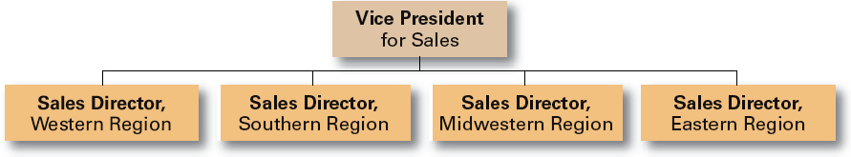
Geographical Departmentalisation
Advantages
  More effective and efficient handling of specific regional issues that arise
  Serve needs of unique geographic markets better (ability to understand better on local requirement /trend/market)
Disadvantages
  Duplication of functions
  Can feel isolated from other organisational areas

Slide 9
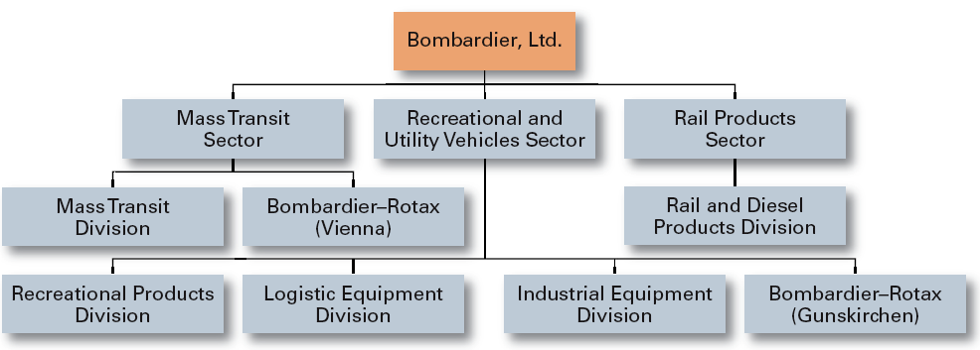
Product Departmentalisation
+ Allows specialisation in particular products and services
+ Managers can become experts in their industry/(field)
+ Closer to customers (for better understanding customers’ need)
– Duplication of functions
– Limited view of organisational goals (due to area of specialisation)

Slide 10
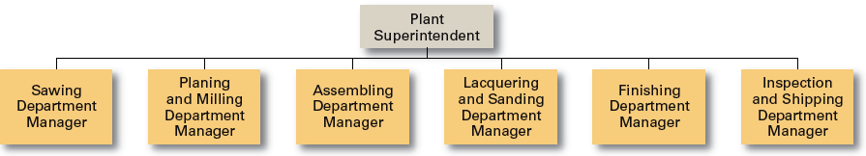
Process Departmentalisation
+ More efficient flow of work activities (specifically in manufacturing/factory environment)
– Can only be used with certain types of products (non flexible, changes may have major effect on the organisation, downtime, idling)

Slide 11
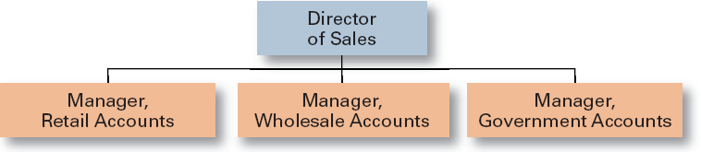
Customer Departmentalisation
+ Customers’ needs and problems can be met by specialists
- Duplication of functions
- Limited view of organisational goals

Slide 12
Designing Motivating Jobs
Job.
  A collection of tasks performed in support of organisational objectives.
Job design.
  The process of creating or defining jobs by assigning specific work tasks to individuals and groups.
Jobs should be designed so that both performance and satisfaction result.

Slide 13
Designing Motivating Jobs (cont’d)
Job design alternatives:
  A good job provides a good fit between the individual worker and task requirements.
  Vary along a continuum ranging from high to low task specialisation.
    High specialisation ⇒ job simplification
    Moderate specialisation ⇒ rotation and enlargement
    Low specialisation ⇒ job enrichment

Slide 14
Designing Motivating Jobs (cont’d)
Job simplification.
  Standardising work procedures and employing people in well-defined and highly specialised tasks.
  Simplified jobs are narrow in job scope and low in job depth.
  Automation.
    Total mechanisation of a job.
    Most extreme form of job simplification.

Slide 15
Designing Motivating Jobs (cont’d)
Job rotation and job enlargement:
  Expands job scope.
  Job rotation.
    Increases task variety by periodically shifting workers among jobs involving different task assignments.
  Job enlargement.
    Increases task variety by combining two or more tasks previously assigned to separate workers.
    Horizontal loading.

Slide 16
Designing Motivating Jobs (cont’d)
Job enrichment.
  Building more opportunities for satisfaction into a job by expanding its content.
  Expands both job scope and job depth.
  Frequently accomplished through vertical loading.

Slide 17

Organisation Structure (cont’d)
Chain of Command
  The continuous line of authority that extends from upper levels of an organisation to the lowest levels of the organisation and clarifies who reports to who.

Slide 18
Organisation Structure (cont’d)
Span of Control
  The number of employees who can be effectively and efficiently supervised by a manager.
  Width of span is affected by:
    Skills and abilities of the manager
    Employee characteristics
    Characteristics of the work being done
    Similarity of tasks
    Complexity of tasks
    Physical proximity of subordinates
    Standardisation of tasks

Slide 19
Flat and Tall Organisation
A flat organisation has relatively few levels in its hierarchy of authority.
A tall organisation has relatively many levels in its hierarchy of authority.
Flatness versus tallness is an index of the vertical division of labour.
Flatness and tallness are associated with the average span of control.

Slide 20
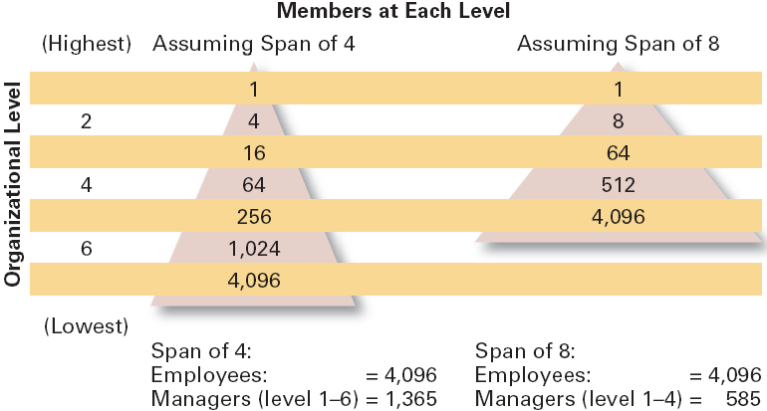
Contrasting Spans of Control

Slide 21
Organisation Structure (cont’d)
Centralisation
  The degree to which decision-making is concentrated at a single point in the organizations.
Decentralisation
  Organisations in which decision-making is pushed down to the managers who are closest to the action.
Employee Empowerment
  Increasing the decision-making authority (power) of employees.

Slide 22
Organisation Structure (cont’d)
Formalisation
  The degree to which jobs within the organisation are standardised and the extent to which employee behavior is guided by rules and procedures.
    Highly formalised jobs offer little discretion over what is to be done.
    Low formalisation means fewer constraints on how employees do their work.

Slide 23
Summary of Main Teaching Points
  Define organisational structure and explain how it corresponds to division of labour.
  Discuss the relative merits of various forms of departmentalisation.
  Review the more basic and more elaborate means of achieving organisational coordination.

Slide 24
Question and Answer Session
Q & A

Slide 25
Next Session
Topic and Structure of next session
NEXT LESSON:
Employee Recruitment, Selection, Training and Development

